Slide 1
SALARY PREDICTION FOR ENGINEERING GRADUATES
Final Presentation
Presented By:-
Group No. 6
PGP DSE June 2020
Gurugram
Research Supervisor:-
Mr Shashank Shirude

Slide 2
Table Of Contents
Introduction
Problem Statement
Dataset Description
Exploratory Data Analysis
Feature Engineering
Building Base Model
Model Evaluation

Slide 3
1. Introduction
AMCAT or Aspiring Minds Computer Adaptive Test evaluates candidates on the basis of their core skills which includes reasoning skills, quantitative aptitude, English and technical skills. The technical module is different for each candidate and depends on the course or the subject they opt for. It is a standardized test of job skills. The test includes cognitive, domain and personality assessments.

Slide 4
2.Problem Statement
Given a new student profile, can we predict the salary of the engineer based on the historic and AMCAT data.
Can we understand what factors in the labour market determine one’s salary? Is it just one’s skills or there are other factors which influence the return in the labour market? What signals and biases enter the labour market?

Slide 5
3.Dataset Description
For every engineer, AMEO dataset provides anonymized bio data information along with their respective skill scores and employment outcome information. Specifically, the following information is available for every engineer:
1. Scores on Aspiring Minds' AMCAT - a standardized test of job skills. The test includes cognitive, domain and personality assessments.
2. Personal information like gender and date of birth.
3. Pre-university information like 10th and 12th grade marks, board of education and 12th grade graduation year.
4. University information like GPA, college major, college reputation proxy, graduation year and college location.
5. The following employment outcome information is available for every engineer:
First job annual salary
First job title
First job location
Date of joining and leaving of first job

Slide 6
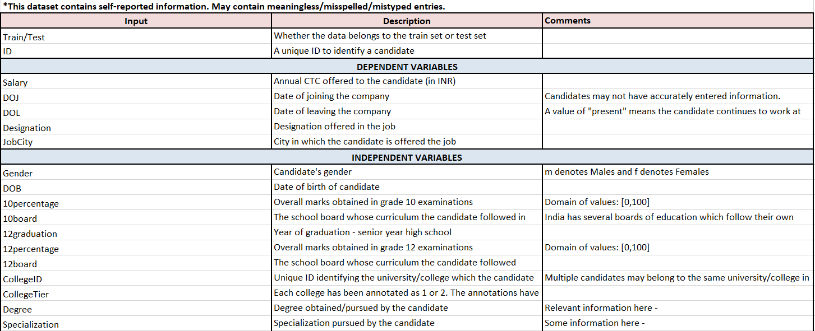
Dataset Description(Cont..)

Slide 7
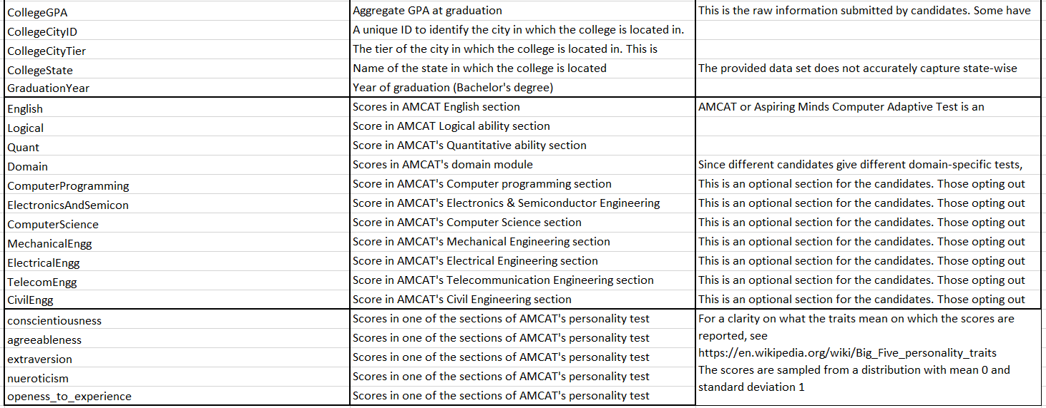
Dataset Description(Cont..)

Slide 8
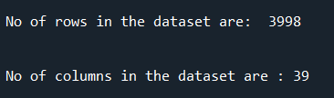
4. Exploratory Data Analysis
Shape of the Dataset
Initially our dataset is spread into 3998 rows & 39 columns

Slide 9
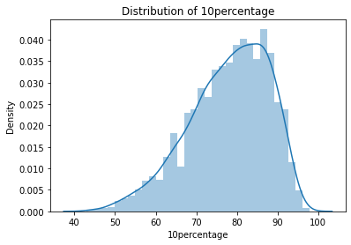
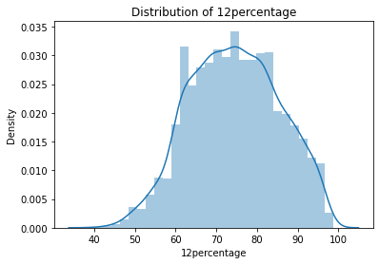
DISTRIBUTION OF DATA
Skewness: -0.591019
Skewness: -0.032607

Slide 10
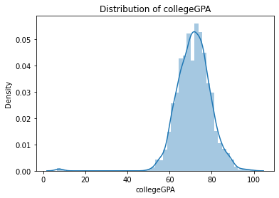
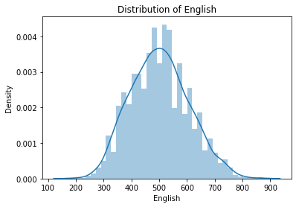
DISTRIBUTION OF DATA
Skewness: -1.249209
Skewness: 0.191997

Slide 11
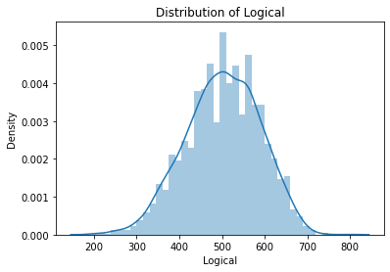
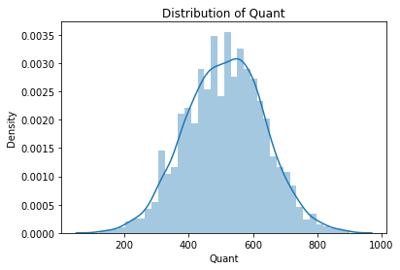
DISTRIBUTION OF DATA
Skewness: -0.216602
Skewness: -0.019399

Slide 12
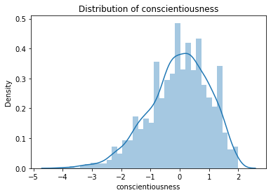
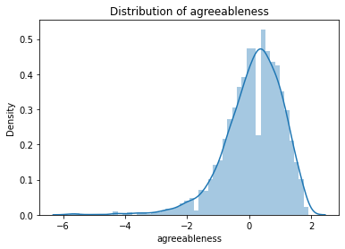
DISTRIBUTION OF DATA
Skewness: -0.522993
Skewness: -1.208386

Slide 13
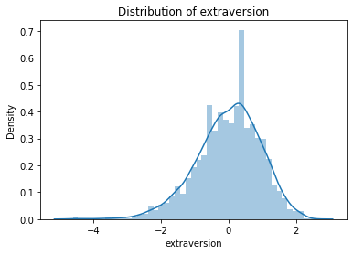
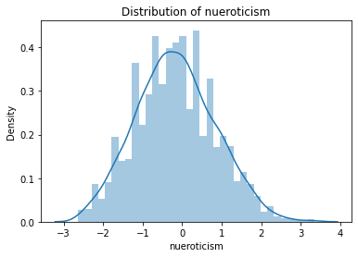
DISTRIBUTION OF DATA
Skewness: -0.521898
Skewness: 0.167075

Slide 14
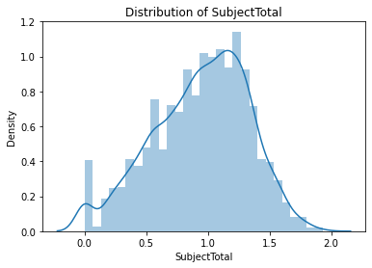
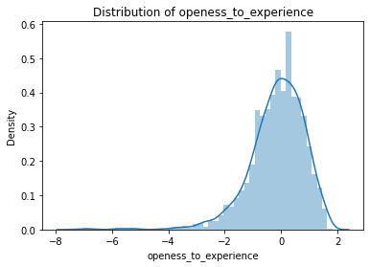
DISTRIBUTION OF DATA
Skewness: -1.502125
Skewness: -0.366986

Slide 15
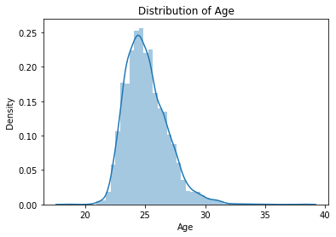
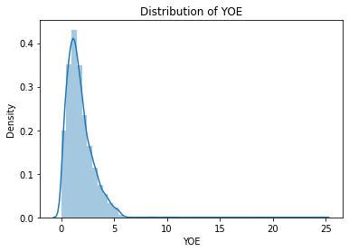
DISTRIBUTION OF DATA
Skewness: 0.912802
Skewness: 2.621372

Slide 16
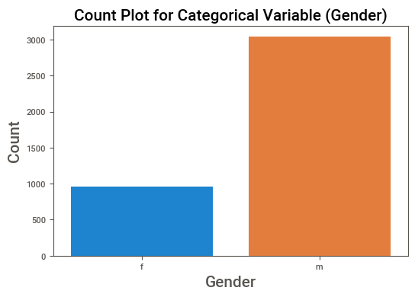
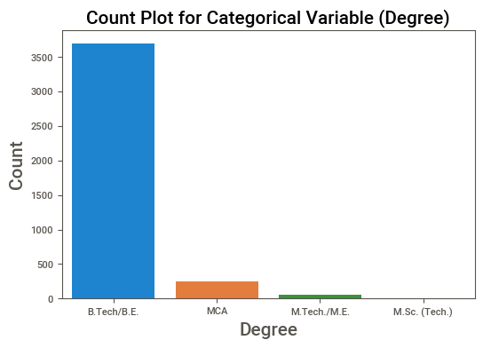


DISTRIBUTION OF CATEGORICAL DATA

Slide 17
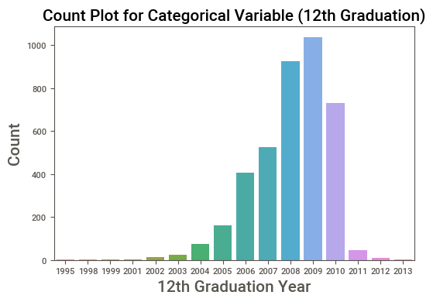
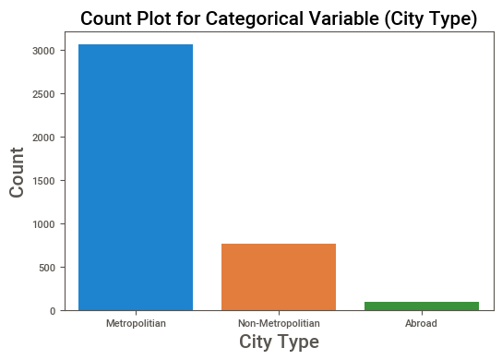
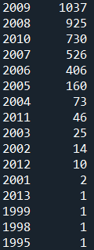

DISTRIBUTION OF CATEGORICAL DATA

Slide 18
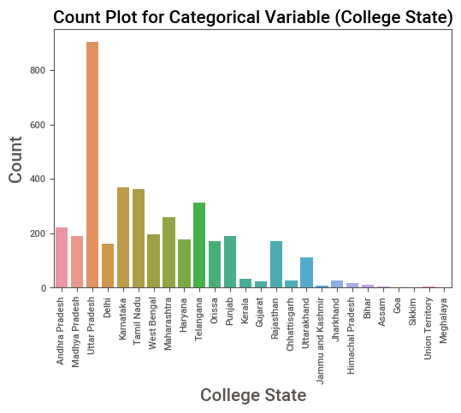
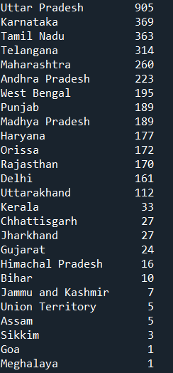
DISTRIBUTION OF CATEGORICAL DATA

Slide 19
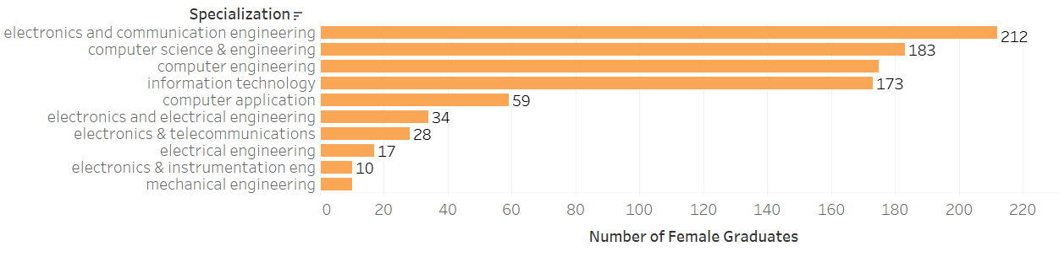
BI-VARIATE ANALYSIS
Top 10 specializations opted by women along with their counts

Slide 20
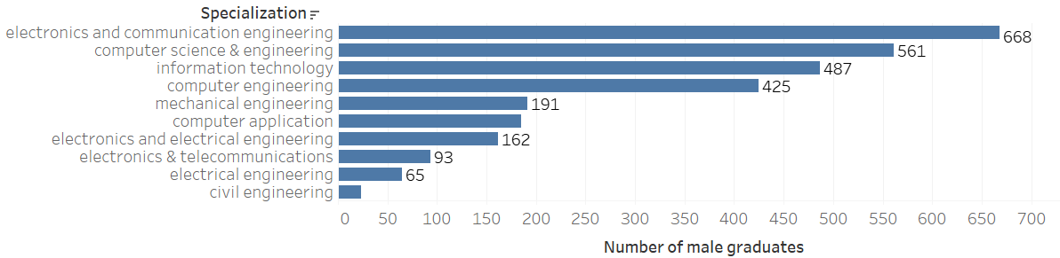
BI-VARIATE ANALYSIS
Top 10 specializations opted by men along with their counts
Both male and female are interested in same specializations having electronics and communication, computer science & engineering as most popular specializations.

Slide 21
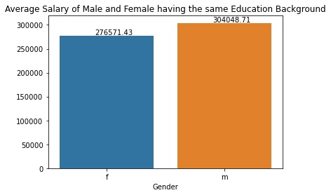
BI-VARIATE ANALYSIS
According to the chart, there is a miniscule difference in the average salary based on gender, considering the same education background (Electronics & Communication Engineering).

Slide 22
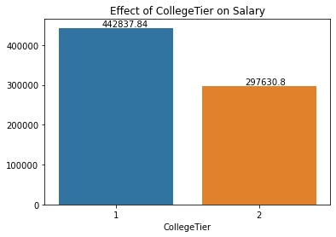
BI-VARIATE ANALYSIS
According to the chart, on average, candidates from Tier 1 college are getting more salary than the candidates from tier 2 college.

Slide 23
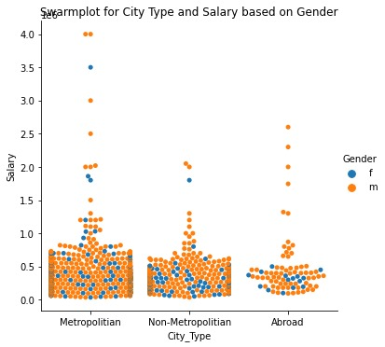
MULTI-VARIATE ANALYSIS
According to the chart, candidates living in metropolitan cities are getting the highest salary followed by candidates living abroad, then candidates in non-metropolitan cities.
For metropolitan and non-metropolitan cities, both are gender present in all salary classes, whereas, for abroad cities, females are present in Low salary class whereas males are getting Good and Average salaries.

Slide 24
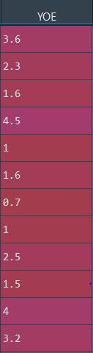
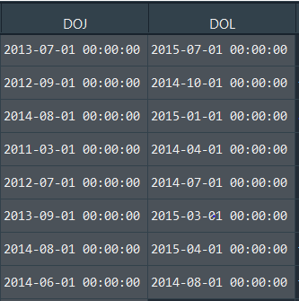
5. Feature Engineering
YOE (years of experience)
Creating YOE (years of experience feature using DOJ & DOL

Slide 25
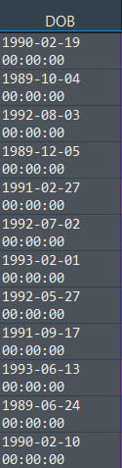
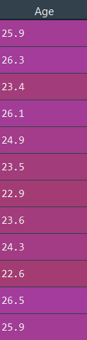
5. Feature Engineering
AGE
Creating AGE feature using DOB feature and taking the date at which the data was collected i.e. 31-12-2015

Slide 26
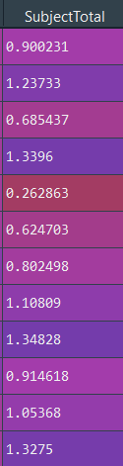
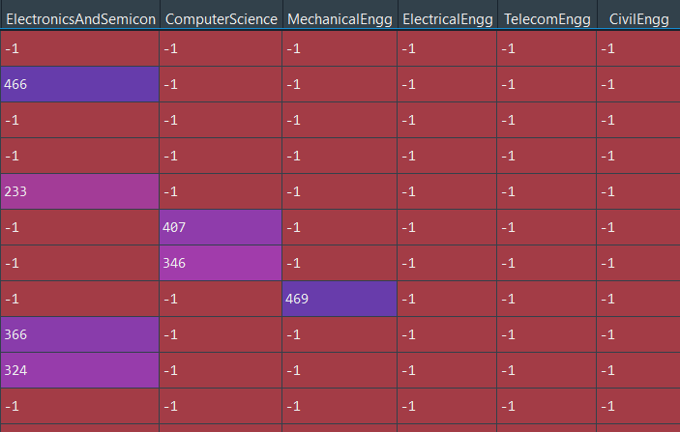
5. Feature Engineering
Subject Total
Creating “subjectTotal” feature using the sum of subject marks of the candidate and then scaled it.

Slide 27
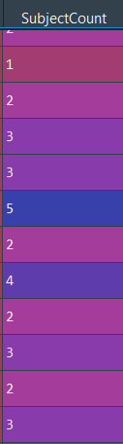
5. Feature Engineering
Subject Count
Creating “subjectCount” feature using the count of subject chosen by the candidate.

Slide 28
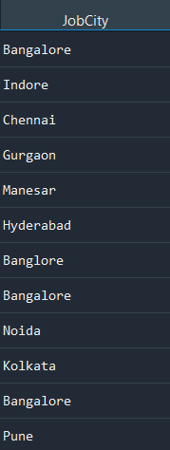
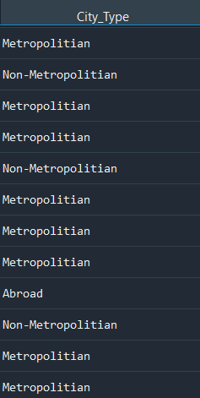
5. Feature Engineering
City Type
Creating “City_Type” feature based on the type of “JobCity”.

Slide 29
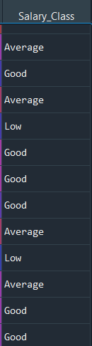
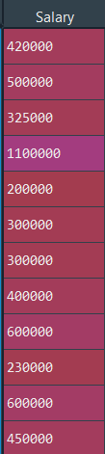
5. Feature Engineering
Salary Class
Creating “Salary Class” feature by applying
K-Means Clustering on “Salary” feature.

Slide 30
5. Feature Engineering
Salary Class
Creating “Salary Class” feature by applying
K-Means Clustering on “Salary” feature.
We have got 4 Clusters in “Salary Class”:
Low
Good
Average
High

Slide 31
5. Feature Engineering
Salary Class
Creating “Salary Class” feature by applying
K-Means Clustering on “Salary” feature.
We have got 4 Clusters in “Salary Class”:
Low
Good
Average
High
Based on the “Salary Class”, We will build classification model

Slide 32
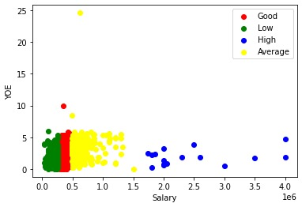
5. Feature Engineering
Salary Class
Clusters based on “Salary” & “YOE”

Slide 33
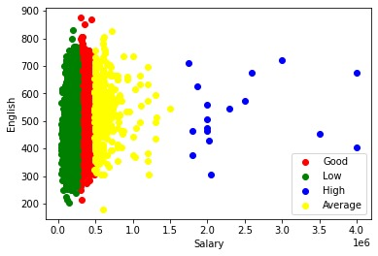
5. Feature Engineering
Salary Class
Clusters based on “Salary” & “English”

Slide 34
6. BASE MODEL
Since our problem is of multiclass classification, we would need to build multiclass classification model.
While choosing algorithms to build our model with, we decided that since Decision Tree, Bagging technique like Random Forest and Boosting technique like XG Boosting are common models used in industry, we would try the same.

Slide 35
6.1 BUILDING BASE MODEL
We decided to proceed with all the basic models –Decision Tree, Random Forest and XG Boost.
We ran all models without any hyper parameter tuning, to get an idea of the base performances of these models and yielded results using K-Fold Cross Validation of each model.

Slide 36
BASE MODEL RESULTS
Model | Accuracy Score | F1 Score | Precision | Recall
Decision Tree | 67.41% | 67% | 67% | 67%
Random Forest | 68.15% | 67% | 67% | 67%
Gradient Boost | 67% | 66% | 67% | 67%
XG Boost | 70.57% | 70% | 71% | 71%
From the above result we can say that XG Boost rein supremacy in every aspect. Hence we will build our final model using XG Boost.

Slide 37
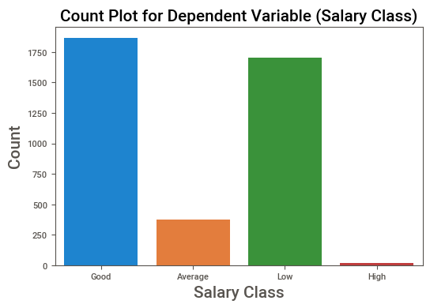
6.2 CLASS IMBALANCE
From the plot we can see that there is high imbalance in our classes.
Therefore we should use oversampling technique: SMOTE to solve the imbalance problem.

Slide 38
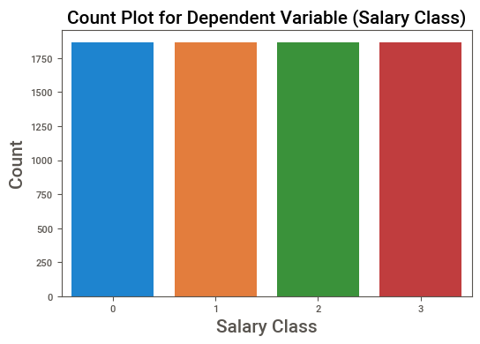
APPLYING SMOTE
From the plot we can see that there is high imbalance in our classes.
Therefore we will use oversampling technique: SMOTE to solve the imbalance problem.
The total number of observations was now 7,460 which was 3,958 before

Slide 39
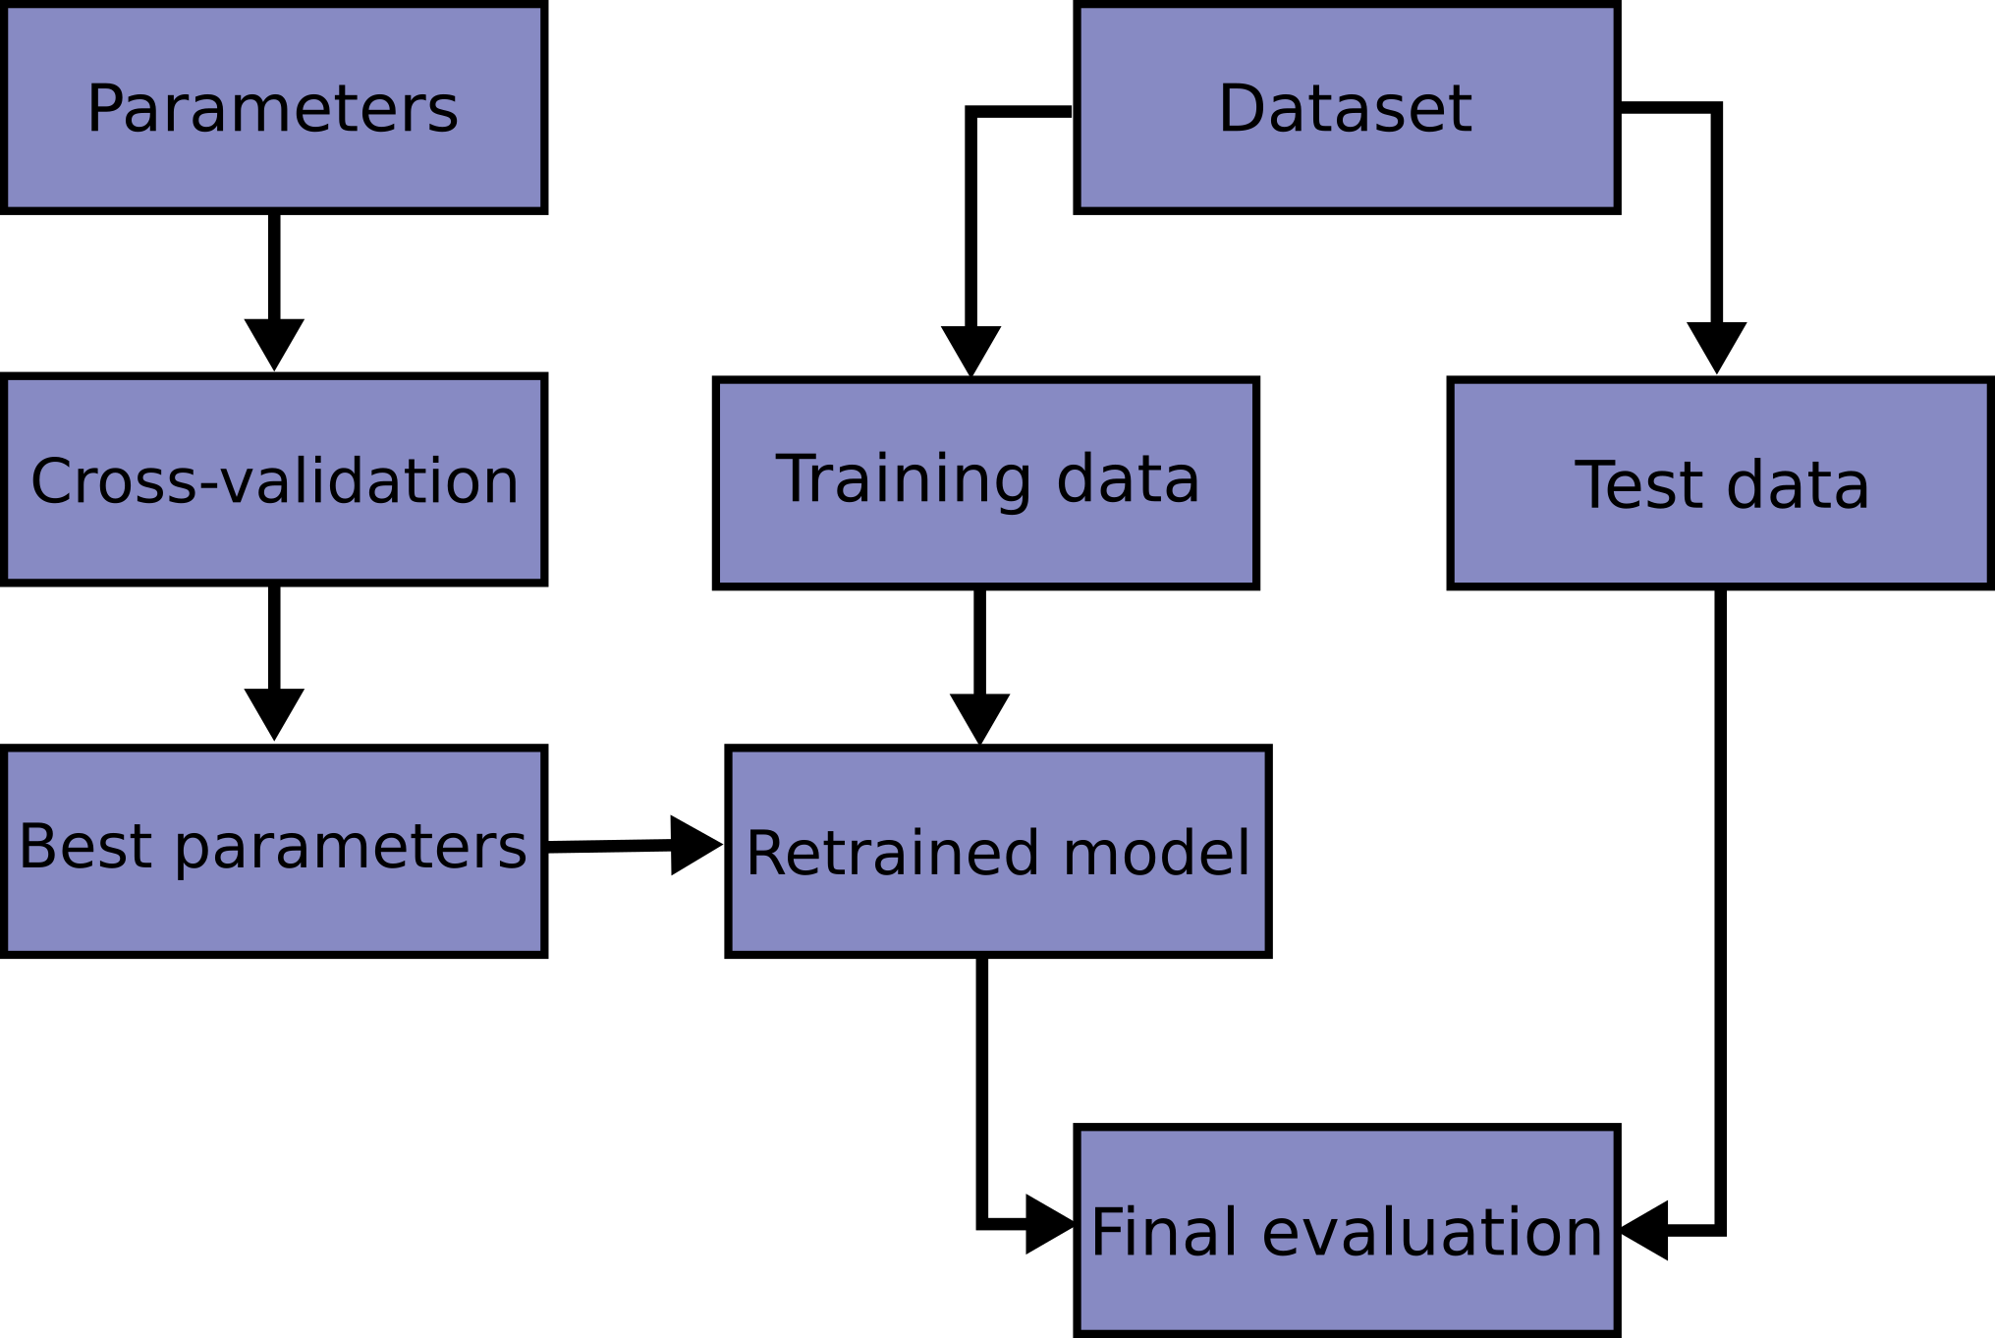
6.3 HYPER PARAMETER TUNING USING GRID SEARCH CV
Best parameters for XGBoost classifier:
{'gamma': 3, 'learning_rate': 0.3, 'max_depth': 5}

Slide 40
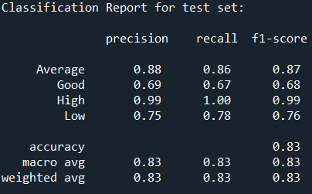
7. Model Evaluation
After building the XG Boost model with best parameters, we get the following precision, recall & f-1 scores
Accuracy - Accuracy is the most intuitive performance measure and it is simply a ratio of correctly predicted observation to the total observations.
Precision - Precision is the ratio of correctly predicted positive observations to the total predicted positive observations.
Recall (Sensitivity) - Recall is the ratio of correctly predicted positive observations to the all observations in actual class
F1 score - F1 Score is the weighted average of Precision and Recall.

Slide 41
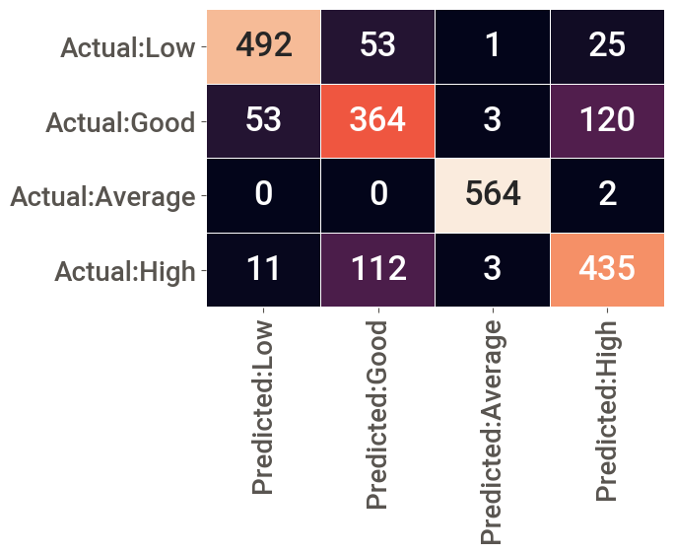
7. Model Evaluation & Insights
We got a 4x4 Confusion Matrix

Slide 42
7.1 FEATURE IMPORTANCE
Feature importance is one of the techniques to analyze the importance of each independent variable on the target variable.
We have used XGBoost Classifier as our model, and it has functions to calculate feature importance under the sklearn library.

Slide 43
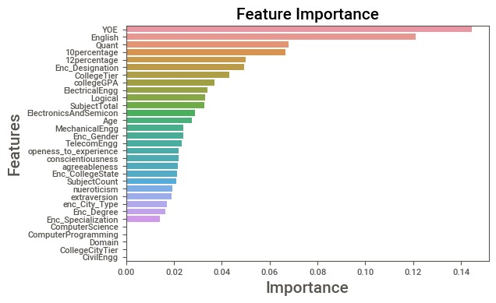
The following bar graph depicts the top features having feature importance in descending order

Slide 44
Thank You

